Slide 1
Exploring communities with 'vegan' - an introduction to community analysis
An Bui
23 November 2019
Southern California All Hands useR Meetup

Slide 2

What is community analysis?
Two main goals:
Describe basic characteristics about your communities
Community 1
Community 2
How many species are there?
How diverse are these communities?
Communities and patterns
‘vegan’
Analysis

Slide 3
What is community analysis?
Two main goals:
Describe basic characteristics about your communities
Determine effects of environmental factors or groupings on community patterns
Community 1
Community 2
How do these communities differ by location?
By food availability?
Communities and patterns
‘vegan’
Analysis

Slide 4
What is community data?
Community members can be counted in a site x species matrix
Community 1
Community 2
Community 1 | 1 | 2 | 2 | 0
Community 2 | 0 | 1 | 0 | 3
Communities and patterns
‘vegan’
Analysis

Slide 5
What is ‘vegan’?
The gold standard tool for community analysis!
Developed by Jari Oksanen (University of Oulu, Finland)
Contains many different functions for analyzing multivariate data
Communities and patterns
‘vegan’
Analysis

Slide 6

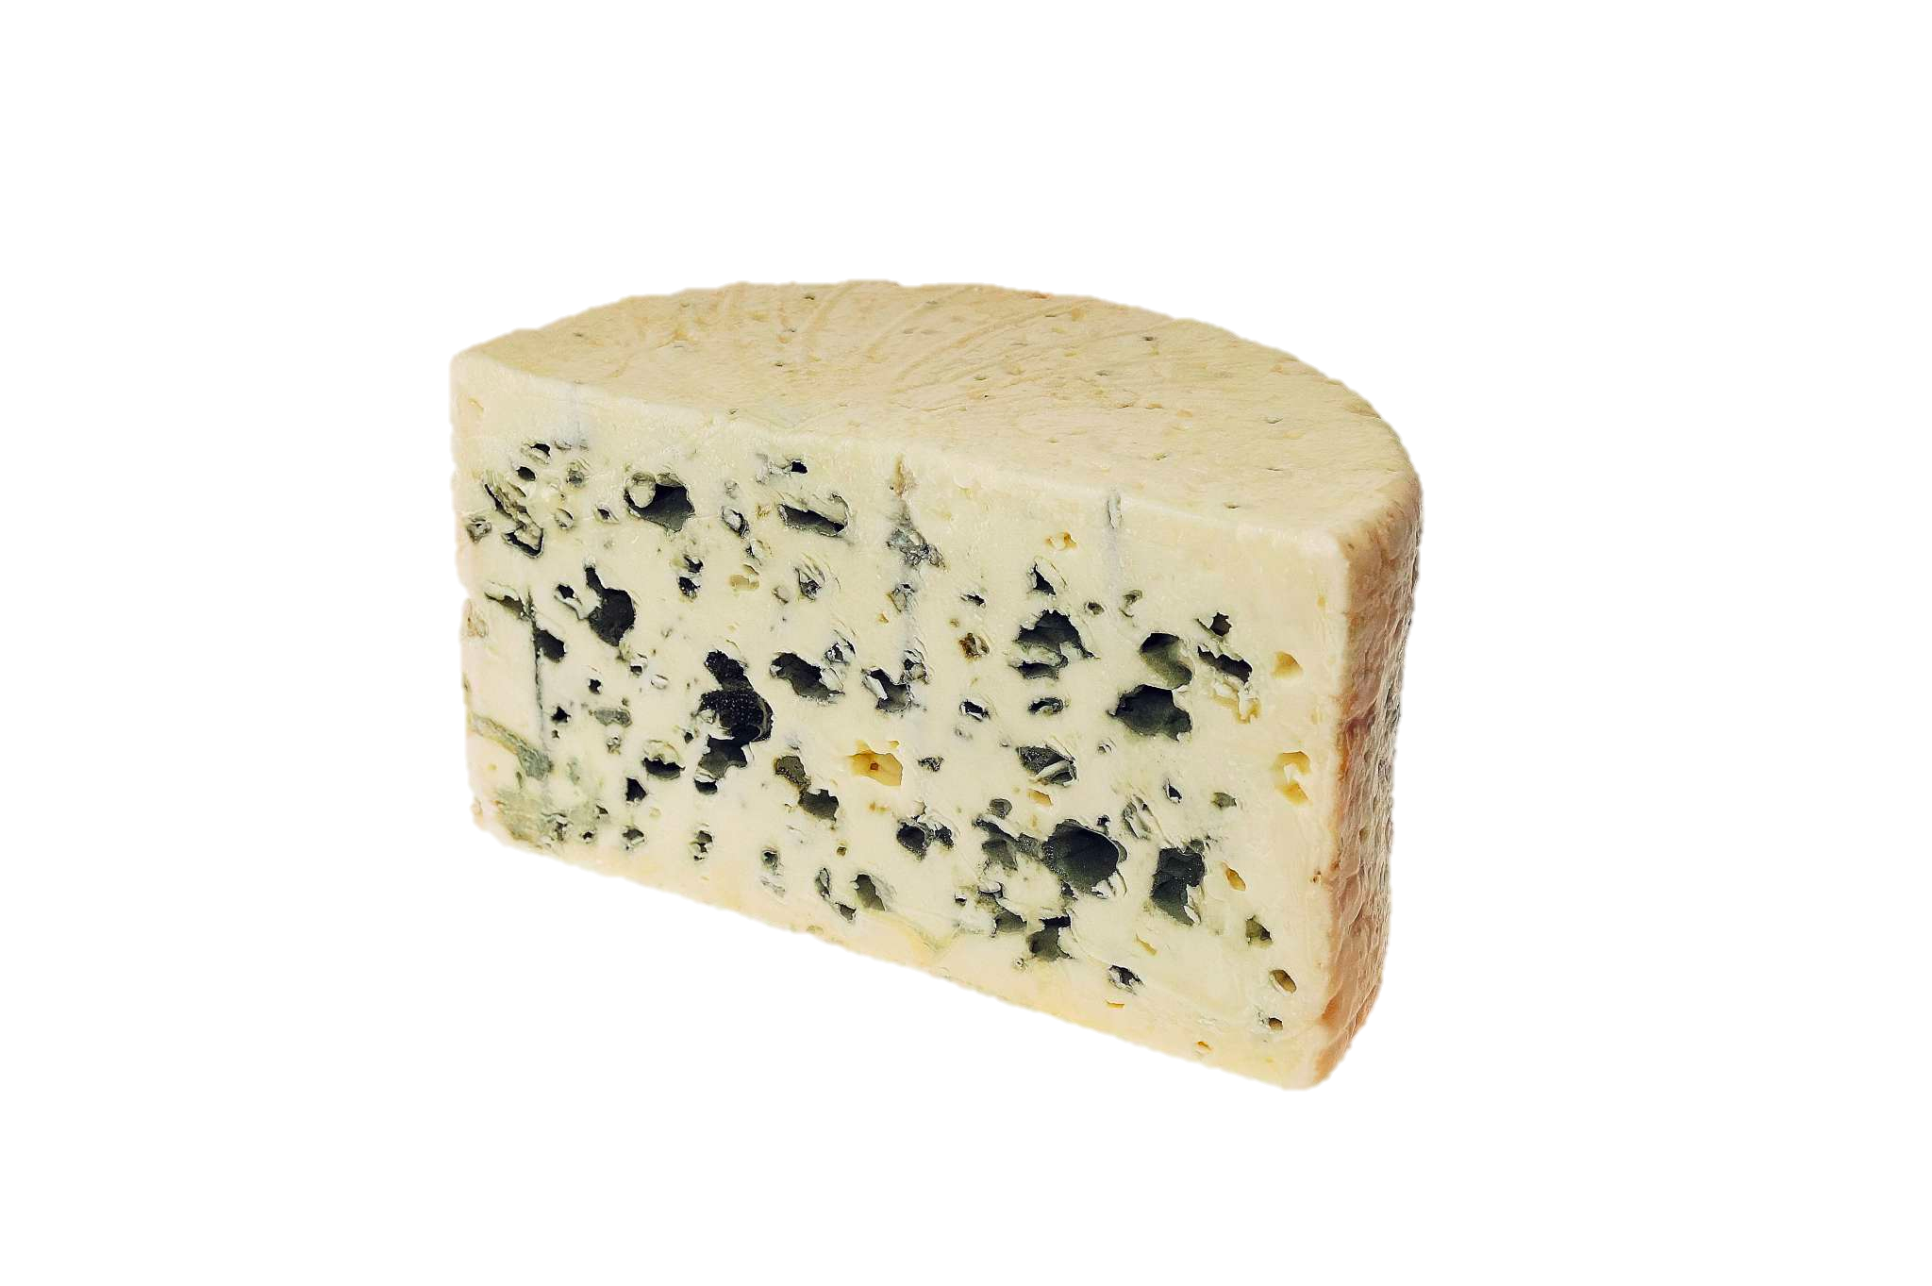
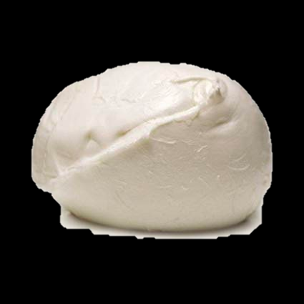
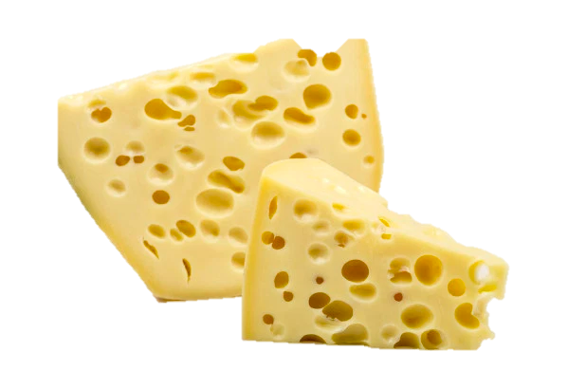
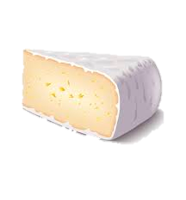
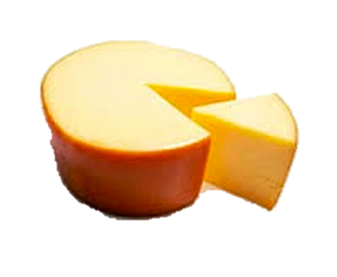
Any multivariate dataset can be analyzed using tools in ‘vegan’
Communities and patterns
‘vegan’
Analysis

Slide 7
How do cheese offerings in cheese shops differ by signature wine pairing?
Bordeaux
Chardonnay
Riesling
Communities and patterns
‘vegan’
Analysis

Slide 8
When grouped by wine pairings...
... how many cheeses do these shops offer?
vegan::specnumber()
Communities and patterns
‘vegan’
Analysis

Slide 9
When grouped by wine pairings...
... are the cheeses at each shop different from each other?
vegan::adonis()
vegan::metaMDS()
“similarity” index
Communities and patterns
‘vegan’
Analysis

Slide 10
When grouped by wine pairings...
... are the cheeses at each shop different from each other?
vegan::adonis()
vegan::metaMDS()
Bordeaux
Chardonnay
“similarity” index
Riesling
Communities and patterns
‘vegan’
Analysis

Slide 11
Extending to other examples of (real) datasets...
Health care: How does a community’s proximity to a general physician affect the types of cases its residents present at a hospital?
Marketing: How does the target demographic’s income predict the kinds of products they will purchase?
Sociology: Does a neighborhood’s cultural background predict the projects in which the community invests?
Communities and patterns
‘vegan’
Analysis

Slide 12
Main takeaways
Multivariate datasets exist in all fields of academia and industry
Using tools that have been developed for community ecology may lend insights into patterns within data
‘vegan’ is a package to help you do just that!

Slide 13
Let’s talk!
An Bui
Twitter: @_anbui

